Slide 1


www.bwa.org.in
Emergency First Responder
Course on First Aid

Slide 2
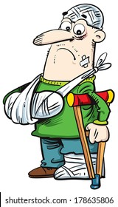
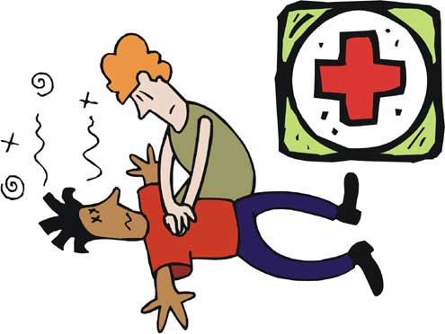
FIRST AID

Slide 3

What is First Aid?
First aid is the temporary and immediate care of a person who is injured or ill.
Aim of First Aid:
  To restart breath (CPR), if needed
  To stop bleeding as possible
  To prevent further injury
  To prevent condition from worsening
  To control shock

Slide 4
BASIC LIFE SUPPORT FLOW CHART
Incident
Check Danger
Remove Danger
Check Response

Slide 5
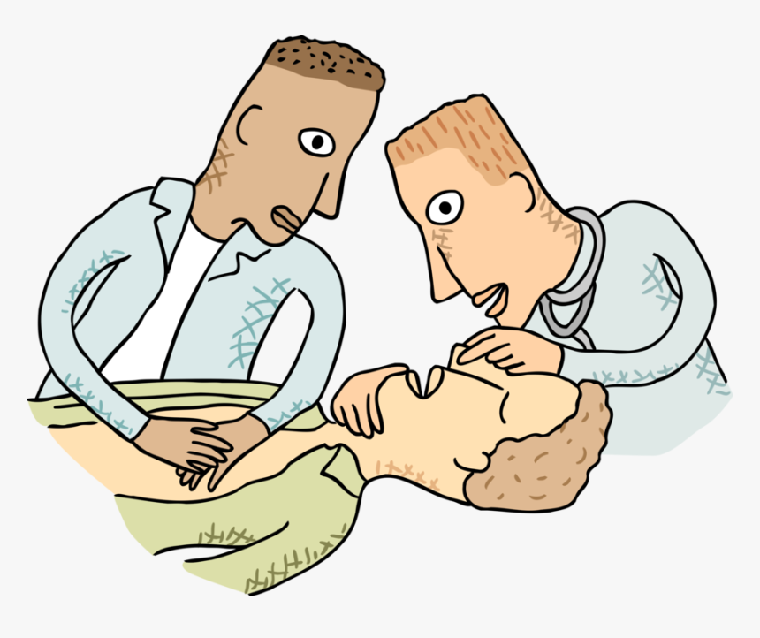
CPR
Cardio Pulmonary Resuscitation

Slide 6
CPR is the First Aid procedure
used to Restart Breathing
If a person is unconscious and
NOT Breathing, we apply CPR

Slide 7
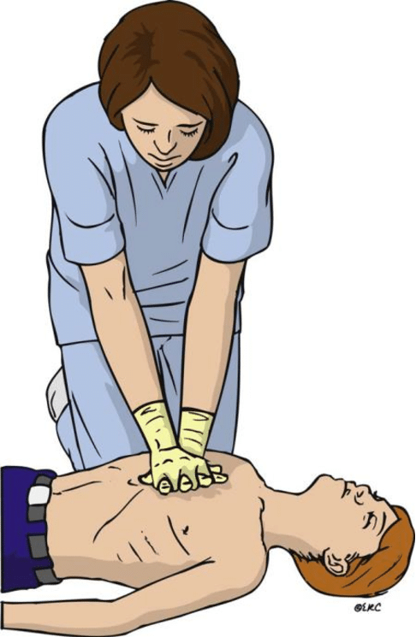
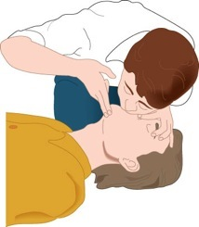
CPR =
Chest Compression
+
Breathing

Slide 8
Ratio of
CPR (Cardio Pulmonary Resuscitation) is
30 ECC (External Chest Compression
+
2 EAR (Expired Air Resuscitation)
– Breath
30 Compression on Chest in 15 seconds
2 Breath in 5 seconds

Slide 9
1 cycle of CPR
30 Compression + 2 Breathing in 20 sec
3 Cycles of CPR in 1 minute
Continue CPR till Breathing restarts

Slide 10
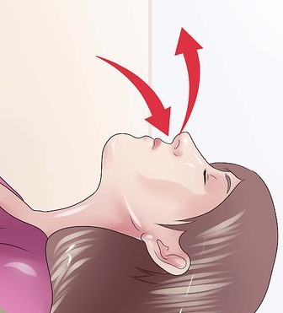

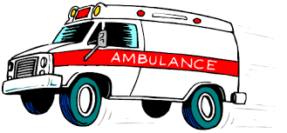


Stop CPR
When Breathing restarts
When Medical Help/
EMS/ Ambulance Arrives
When you are too tired

Slide 11
To do Primary Assessment (check breath)
and consequent actions (CPR)
We follow
DRABC + (D)

Slide 12
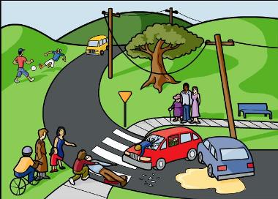
D = Danger
Check for Danger of Self, Bystander and Victim
Remove Dangers (if any)
Or remove victim from Danger

Slide 13
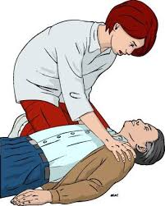
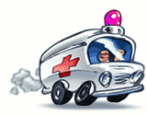
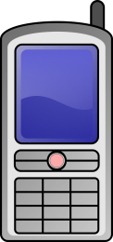

R= Response
Check Response (Conscious or Unconscious)
Tap on shoulder, Talk to victim
If Irresponsive (Unconscious)
Call for Medical Help

Slide 14
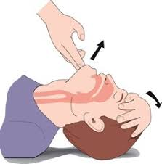
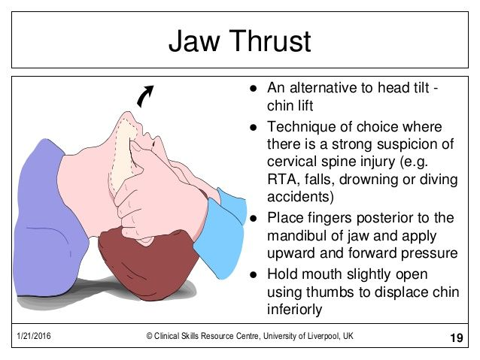
A= Airway
Open Airway
Tilt the head backward
Jaw thrust
(for spinal injury)
Or

Slide 15
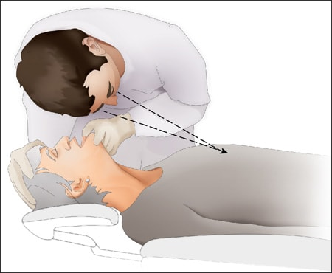
B = Breathing
Check Breathing
Look, Listen and Feel for Breath (5-10 sec)
If Breath absent, Start CPR

Slide 16
C= Compression
CPR is started with Chest Compression
Continue CPR
(30 Compression +
2 Breathing)
till Breathing resumes

Slide 17
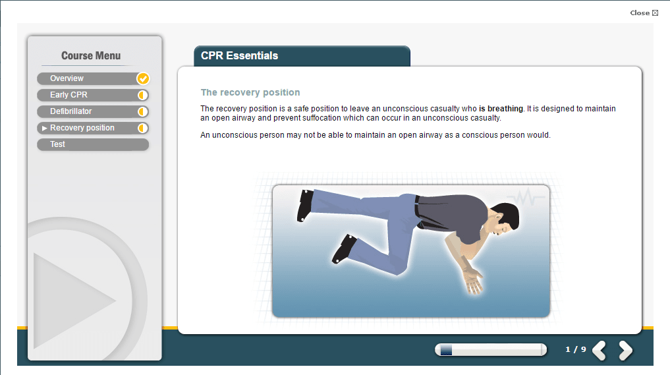
If the breathing starts, put the victim in Recovery Position

Slide 18
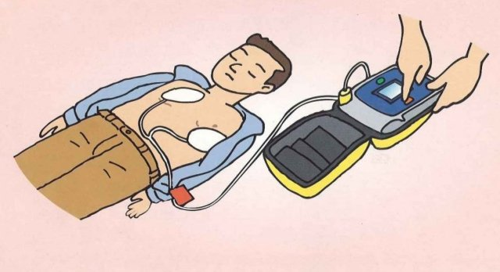
D – Defibrillation
During CPR if AED is available, use AED and follow voice instructions
AED- Automated Electronic Defibrillator

Slide 19
We divide casualties who need CPR
into three age groups :
Adult(above 8 yrs) Child(1-8 yrs)
Infant(below 1 yr)
The depth and method of chest compression and amount of breath to give is different for all age groups
The Ratio of CPR is same for all ages
30 Compression : 2 Breathing, 3 cycle in 1 minute

Slide 20
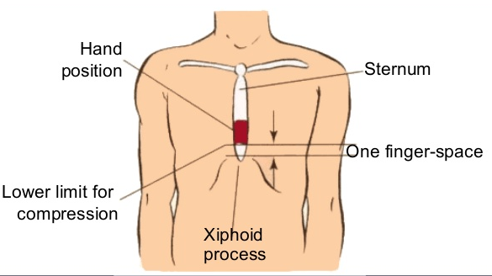
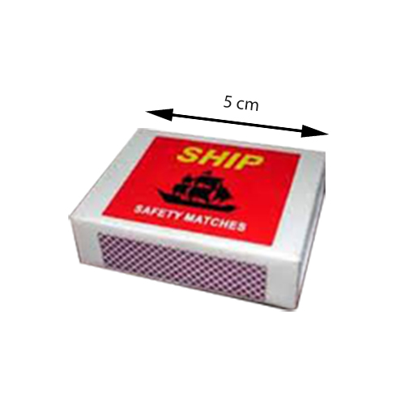
CPR to adult (above 8 years old)
Depth of Compression is 4-5 cm or 1⅟₂ - 2 inch
Compress using both hands
Amount of Breath
approx. 500ml (Full breath)

Slide 21
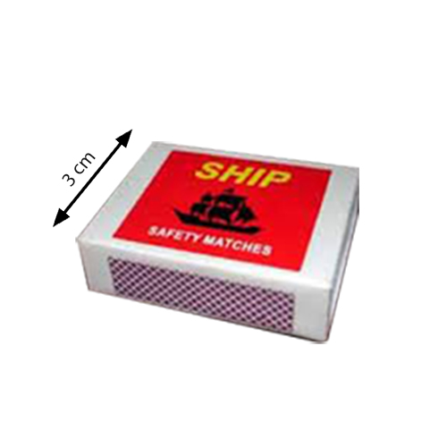
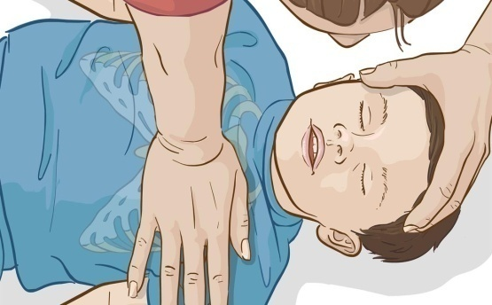
CPR to child (1 - 8 years old)
Depth of Compression is 2-3 cm or 1 inch
Compress using one hand
Amount of Breath approx. 300ml (Half breath)

Slide 22
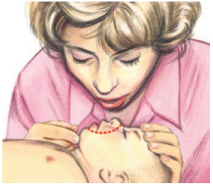
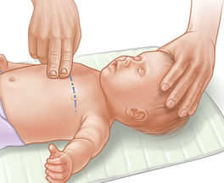
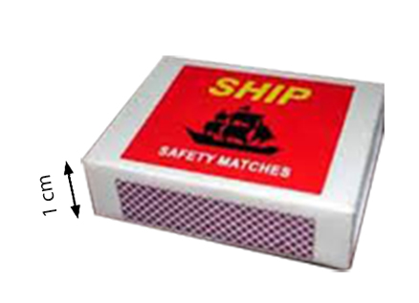
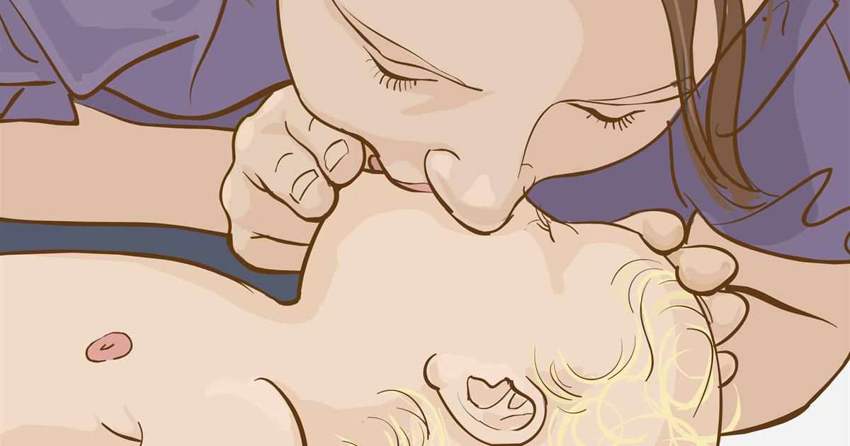
CPR to infant (below 1 year old)
Depth of Compression is 1 cm or ⅟₂ inch
Compress using two fingers
Just below nipple line
Amount of Breath approx. 100ml
Breath should be given
Mouth to Mouth and Nose

Slide 23
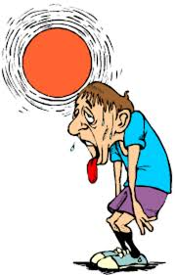
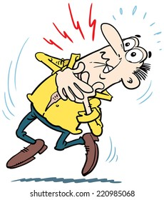
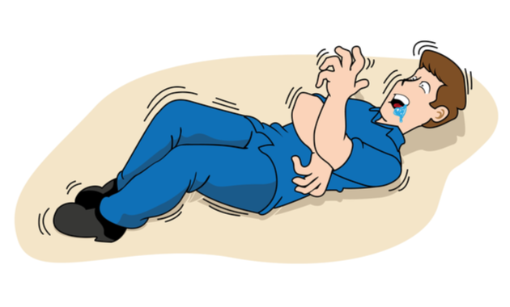
Some Important
Medical Emergencies
And their First Aid

Slide 24
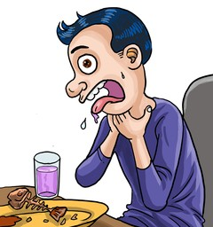
Choking
Choking is
partial or complete
obstruction of airway

Slide 25
Symptoms:
(Mild Obstruction)
Victim coughing
Maybe grabbing the throat
Able to breath , speak or cough
(Sever Obstruction)
Victim gasping for breath
Grabbing the throat
Unable to breath, speak or cough
Victim slowly getting unconscious
*For Unconscious victim, you realise choking, during EAR

Slide 26
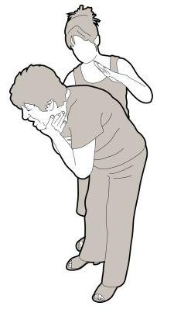
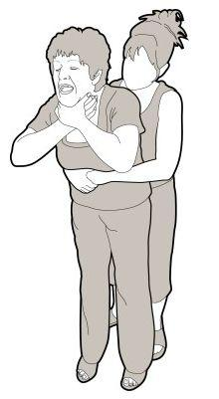
Action:
Encourage the victim to cough
Clear the mouth with finger sweep
5 Back Slap in between shoulder blades
Check mouth and clear if needed
5 Abdominal Thrust
Check mouth and clear if needed
Repeat these steps
**For Unconscious, roll sideway, 5 Back slap, roll back and
30 Chest Compression (CPR), repeat until object dislodge

Slide 27
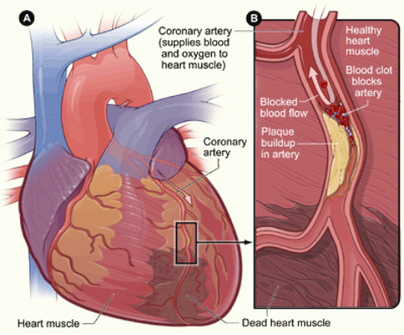
Heart Attack
Heart Attack is
lack of oxygen in heart muscles,
due to blockage in the Coronary Artery, which leads to stoppage or insufficient pumping of heart.

Slide 28
  Symptoms:
  Severe pain in chest spreading to arm/neck
  Difficulty in breathing
  Heavy sweating
  Pale or Bluish lips or nails
  Irregular heartbeat
  Palpitation & fibrillations
  Weakness and anxiety
  Nausea or vomiting
  Dizziness/unconsciousness

Slide 29
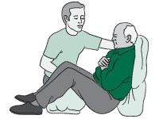
  Action:
  Reassure and calm the victim
  Make victim lie down in
  half-sitting position, with knees bent
  Loosen clothing, particularly
  around neck, chest and waist
  Keep person warm, cover with blanket
  Wipe face and forehead with damp cloth
  Regularly record and monitor pulse and breathing
  If no breath, start CPR
** Don’t Give any food/ water to drink
** Give medicine, only if he/she is on medication

Slide 30
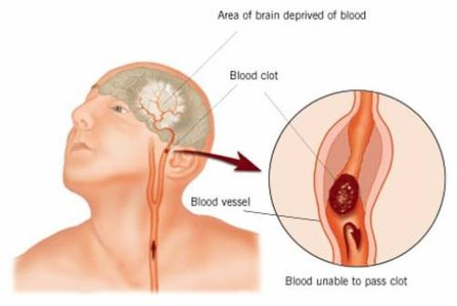
Stroke
Stroke or Brain Attack is
lack of oxygen in brain
due to blockage or cut in Carotid Arteries of brain

Slide 31
  Symptoms:
  Severe Headache
  Signs of paralysis or weakness, often on one side of the body
  Difficulty in speaking, lopsided mouth
  Blurred vision, inequal pupil
  Confusion & disorientation
  Dribbling from one side of mouth
  Loss of consciousness
  Quick Check: FAST
  Face- Look at Face, Eyes inequal, Mouth lopsided
  Arm- Tell victim to raise arms, one arm paralysed
  Speech- Ask simple questions, slurred speech
  Talk to doctor- consult a doctor

Slide 32
  Action:
  Monitor airway and breathing – perform CPR if necessary
  Place in recovery position, if unconscious
  If conscious, help to lie down with head and shoulders slightly raised, head turned sideway
  Keep warm, cover with blanket
  Reassurance
  Call an ambulance, admit to ICU as soon as possible

Slide 33
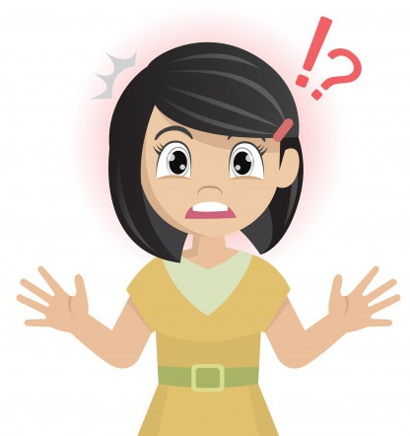
Shock
Shock is caused by 21% or more
oxygen deficiency in vital organs.
Depending on Triggering reason,
Psychogenic/ Emotional Shock:
due to fear, excitement or sudden sad news
Circulatory Shock: due to excessive bleeding
Anaphylactic Shock: due to severe allergic reaction

Slide 34
  Symptoms:
  Restlessness and anxiety
  Victim in dazed state
  Cool sweating
  Shivering
  Pale skin
  Fast shallow breathing /gasping
  Weak Rapid pulse
  Nausea or vomiting
  Unconsciousness
  (for Allergic Shock)
  ●Itching ●Hives ●Flushed Face ●Warm skin

Slide 35
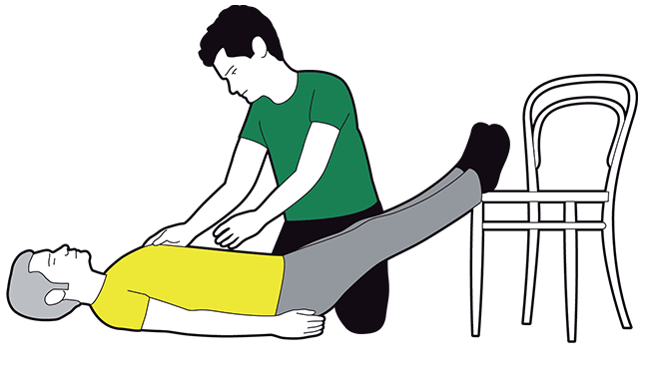
  Action:
  Reassure casualty, Place Hand on Head
  Determine cause, if possible remove it
  Place in lying position with feet raise
  Loosen clothing and make comfortable
  Keep warm, cover with blanket
  Cold compress, if sweats
  If breath stops- start CPR
  In case of Allergic Shock,
  determine cause of allergy,
  quickly consult doctor

Slide 36
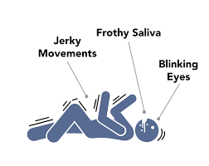
Seizures
Seizure is temporary disturbance in electrical flow
in nervous system, often caused by Epilepsy.
Usually seizure is non fatal,
stops on it’s own in 3-5 min.

Slide 37
  Symptoms:
  Sudden jerky movement
  Body stiffening, muscle spasm
  Drooling
  Clenched jaws
  Unconsciousness

Slide 38
  Action:
  Prevent victim from injuring himself/ herself
  If victim is standing, lay him/her down on ground
  Place pillow,/clothes under head
  Remove any eye glasses/ wrist watch
  Remove surrounding chair/ tables away
  Put spoon wrapped in napkin in mouth to prevent bite on toung
  Do not stop movements
  After movement stops ,Check breath, If not breathing begin CPR

Slide 39
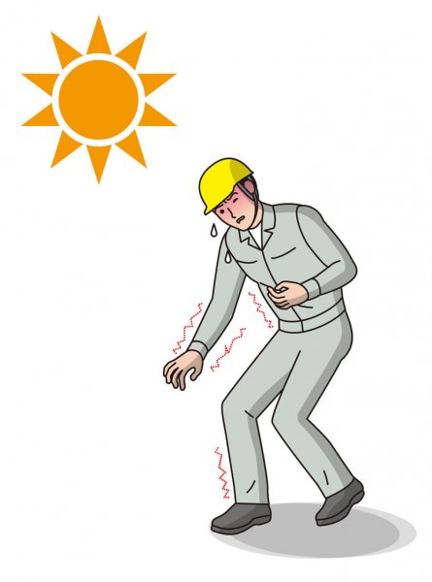
Heat Exhaustion & Heat Stroke
Heat Exhaustion is very much
tiredness due to dehydration
In hot atmosphere.
If heat exhaustion is not stopped
body crosses its limit of sweating,
sweating stops and body becomes
hot , this is Heat Stroke stage.

Slide 40
Symptoms:
Heat Exhaustion
Cool , clammy skin
Sweating
Dilated pupil, confusion
Weak rapid pulse
Headache
Abdominal cramp
Nausea or Vomiting
Heat Stroke
Hot, dry skin
Body temperature 102⁰F / 39⁰C or above
Constricted pupil
Strong rapid pulse
Seizure
Unconsciousness

Slide 41
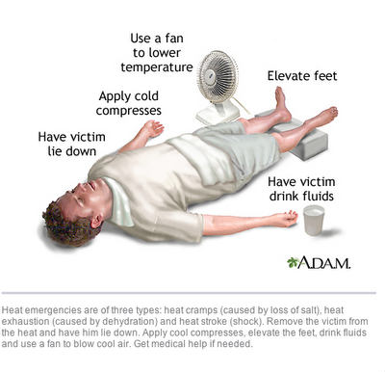
Action:
Heat Exhaustion
Take the victim to shade
Sponge with wet cloth
Fan with electric or hand fan or newspaper
If victim is conscious, give him/ her some cool salty drink to sip
Lay down on back with elevated legs
Heat stroke
Take the victim to shade
Sponge with wet cloth, keep wet cloth at forehead, neck, chest
Fan with electric or hand fan or newspaper
Don’t give water to drink until body cools
Perform CPR, if needed
Lay down on back with elevated legs

Slide 42
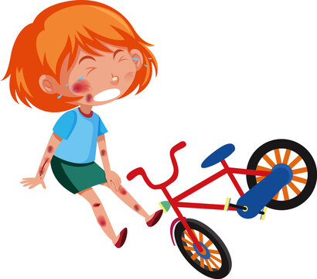
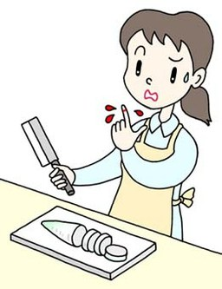
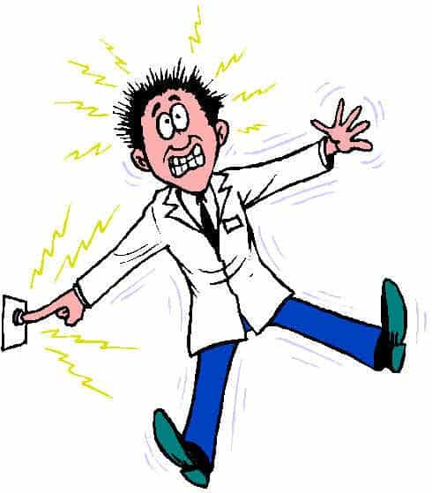
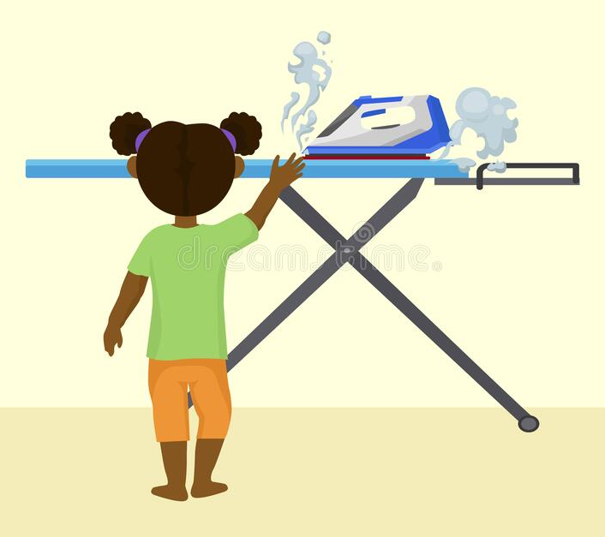
Some Important
Trauma Emergencies
And their First Aid

Slide 43
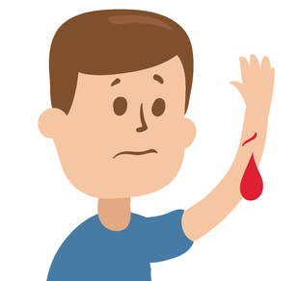
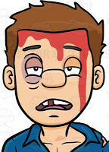
Bleeding
Bleeding is caused due to
cut of blood vessels -
arteries, veins or capillaries.
Blood is always contained within blood vessels.
Even the tiniest bleeding means, there has been cut in any blood vessel.
Amount of Blood = 6.5% - 7.5% of body weight,
5.5 - 6 litres for a person of 80kg.
Loss of 1.5 litres or more can be fatal.

Slide 44
Symptoms:
External Bleeding, where blood comes out of the blood
vessels and out of the body is clearly visible: in injured
part we can see the cut and blood flowing out.
In excessive bleeding, pulse weakens, difficulty in breath
Excessive bleeding may cause Shock, unconsciousness
Internal Bleeding, where blood comes out of the blood
vessels but not out of body, the following symptoms may
be seen:
Bruises/ Black Spots
Blood in vomit/ urine/ stool
Blood from ear/ nose
Weak pulse, Unconsciousness

Slide 45
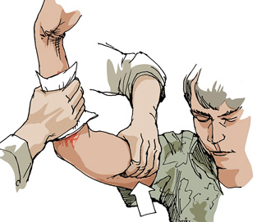
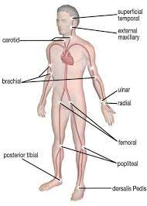
Action:
Clean the wound to prevent infection
Put direct pressure with clean cloth and hold
Elevate the wound above heart level
If blood flow doesn’t stop, Put indirect pressure at arterial pressure point between wound and heart with hand/ tourniquet
After blood flow stops, bandage the wound
Reassure the victim.
Keep him/her at rest

Slide 46
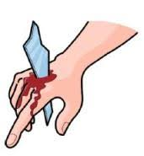
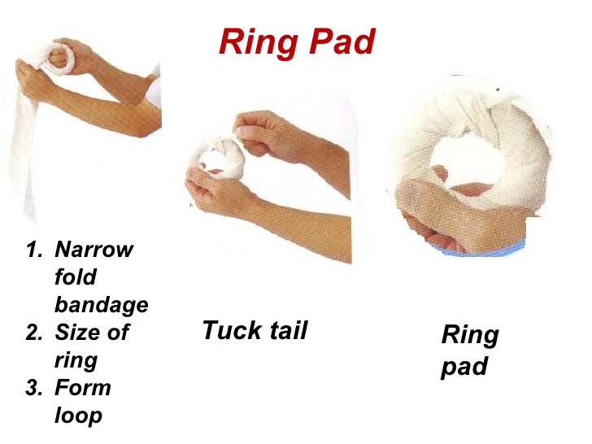
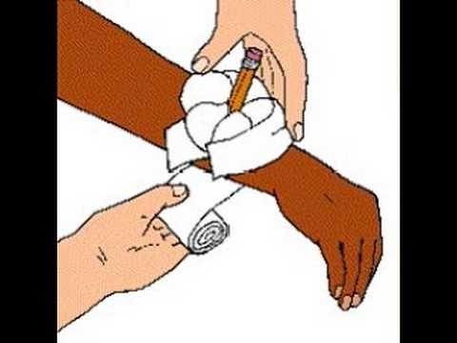
Action:
In case of Embedded object,
Do not remove the object
Make a doughnut bandage and
put pressure around the object
In case of Internal Bleeding, get
medical help as soon as possible

Slide 47
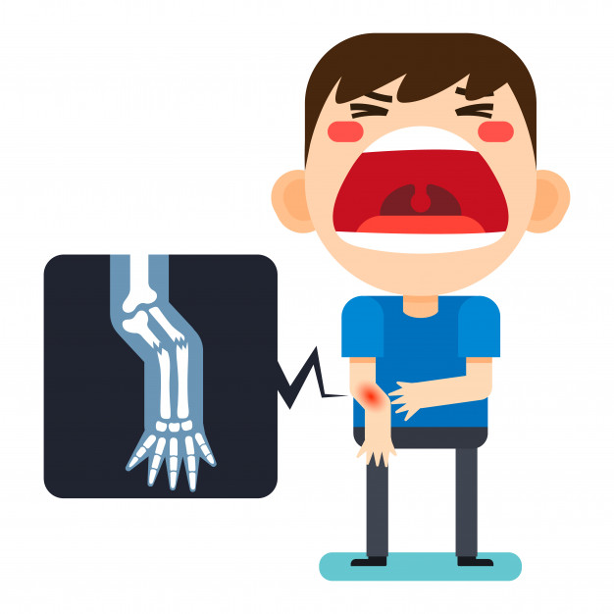


Fracture & Dislocation
Fracture is crack or
break in bones
Dislocation is move out of a bone
from original position in joints

Slide 48
Symptoms:
Body part bent or shifted in abnormal angle
Loss of natural movement
Pain and swelling
Disclouration of skin
Victim feels crunchy sound felt at wound
If the fracture is minor crack, bone is not broken
completely in two pieces, body part may not bend.
But we suspect fracture and treat as fracture.
In case of open fracture, one end of bone comes
out of flesh and skin. It is visible and associated
with bleeding

Slide 49






Action:
Main first aid for fracture or suspected fracture is immobilisation of that body part to prevent further damage
Arm, forearm, wrist, fingers
immobilised using paper,
magazine, splints, slings

Slide 50



Action:
Lower leg can be immobilised using splint , blanket or both
Upper leg / hip joint/ waist should be immobilised using splint up to chest
To relief pain and swelling
apply ice pack
Send to hospital
as quick as possible

Slide 51


Spinal injury
Spinal injury happens due to sudden fall or
heavy object falling on head or neck

Slide 52
Symptoms:
Conscious victims will complain about pain at neck
or at the spine at back
Victims may be unable to clench fists and toes
Victims may feel numbness, loss sensation of touch or
pinch below the site of injury
In case of unconscious victims, depending on
surrounding scenario suspect spinal injury
There may be leak of urine

Slide 53



Action:
Keep the victim still
Immobilise neck movement with
cervical collar.
If readymade not available,
we can make with newspaper and scarf
Hold the head with both hands or
place two towel roll at both sides of head

Slide 54

Action:
Carry the victim on rigid stretcher, lift on stretcher
using log roll, but maintaining spine at neutral position
Call ambulance or send to hospital as quick as possible

Slide 55




Burn
Burn is caused
by contact with
fire, hot objet,
liquid or vapour.
It is damages of
skin and lower
tissues due to
heat.

Slide 56
Severity of burn is determined on two parametres-
area and depth.
Area is measured in Percentages
Depth is measured in Degrees
If the total body surface area is considered 100%,
various parts have surface area of 9% of that.
To estimate total burnt area, we consider this.
30% or more area burnt is considered serious

Slide 57



Percentage of Burn Estimation

Slide 58

Our skin has three layers-
Epidermis, Dermis and
Subcutaneous.
Under that, there is layer of
Muscle and Bones.
Depending on which
layers got damaged,
Degree of Burn is determined.
Epidermis
Dermis
Subcutaneous
Muscles & Bones
Whereas, more the percentage, more life threatening.
Degree of Burn determines the first aid action.

Slide 59
Degree | Layer Affected | Symptoms | First Aid
1st | Epidermis | Redness in skin | Place under flowing water for 20min
2nd | Dermis | Blisters | Cover with wet cloth
3rd | Subcuta- neous | Body fluid oozing | Cover with dry cloth
4th | Muscle & Bone | Charred Black | Do not touch

Slide 60





Slide 61


Electrocution
Electrocution happens
When electricity passes
through our body.
Mainly, it causes damages
to our nervous system and
interrupts with the rhythm
of heart pump, if heart is
in the way of its passing.

Slide 62

Symptoms:
After the jolt, victim is in shocked
state
Dizziness
Muscle pain, tingling sensation
Paralysis of limb
Burn marks at entry and exit point of electricity
In case of unconscious victim, we assume electrocution,
from the presence of electric wire nearby and burn marks in body

Slide 63


Action: Remove Danger or remove victim
Find the switch of the connection
and off it;
If unable to find the switch,
switch off main connection
If unable to switch off, remove the wire using wooden or any
insulator stick, while standing on
rubber mat/thick newspaper

Slide 64



Once danger is removed, check victim’s
condition, apply CPR if needed
Treat burn at entry and exit point,
according to its Degree
Keep the victim lying on back
with elevated legs

