Slide 1


Underwater Diving Operations
Scuba Systems, Surface Supplied Diving (SSD), Hyperbaric Physics, Diving Medical, Communications & Marine Navigation

Slide 2


OPERATIONAL DOMAINS
1. Technical & Equipment
2. Safety & Field Execution
Mastering Open-Circuit Scuba apparatus, Surface Supplied Diving (SSD) umbilical helmets, air banks, and emergency gas supplies.
Diving medical protocols, barotrauma prevention, decompression illness management, and hyperbaric chamber operations.
Understanding hyperbaric physical gas laws (Boyle, Dalton, Henry, Gay-Lussac) and underwater pressure dynamics.
Standardized underwater communication (hand/rope signals), COLREG marine navigation rules, and in-water rescue circuits.

Slide 3
Diving Equipment & Systems
Section 01: Scuba Hardware & Surface Supplied Diving (SSD) Infrastructure

Slide 4

SCUBA LIFE SUPPORT SYSTEMS
Primary Scuba Hardware
Buoyancy & Monitoring
Cylinder: High-pressure aluminum/steel tank (200-300 bar working pressure).
BCD System: Harness with inflatable bladder, low-pressure inflator, and over-pressure relief valves.
First Stage Regulator: Reduces high cylinder pressure to an intermediate pressure (~9-10 bar above ambient).
Alternate Air Source: Secondary second-stage (Octopus) for buddy air sharing emergencies.
Second Stage Regulator: Delivers breathable air at ambient pressure on inhalation demand.
SPG Gauge: Submersible pressure gauge tracking real-time breathing gas reserves.

Slide 5
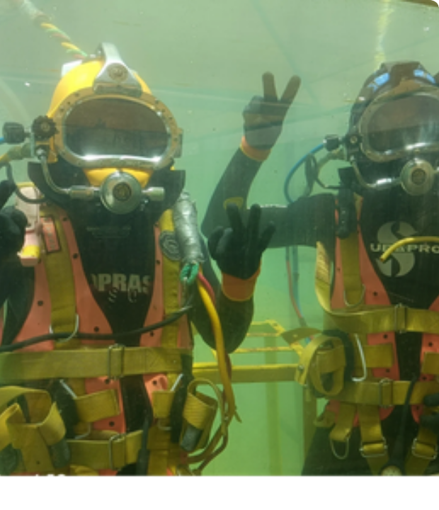
SURFACE SUPPLIED DIVING (SSD)
Surface Air Infrastructure
SSD supplies breathable gas from a surface air compressor or high-pressure gas storage rack via a heavy-duty umbilical hose.
Umbilical Bundle: Consists of an air supply hose, pneumofathometer depth line, communications wire, and strength member.
Headgear: Heavy-duty helmets (e.g., Kirby Morgan KM-37) or bandmasks featuring non-return valves and integrated communications.

Slide 6
SCUBA VS SSD COMPARISON
Operational Feature | Scuba Diving System | Surface Supplied Diving (SSD)
Gas Supply Limit | Restricted to cylinder volume (e.g., 12L @ 200 bar) | Unlimited surface air supply bank / compressor
Communications | Limited to visual hand signals / slate notes | Continuous hardwire voice communications
Safety Reserve | Onboard bailout / buddy octopus system | Emergency Gas Supply (EGS) bailout cylinder
Diver Mobility | High 3D maneuverability & untethered freedom | Restricted by umbilical length & tether drag

Slide 7





SPECIALISED SSD COMPONENTS
EGS Bailout System
Pneumofathometer
Air Control Panel
Harness-mounted high pressure cylinder with emergency first stage connected directly to the helmet selector block for instantaneous switchover.
Surface depth-gauge system that reads pressure reflected back from the diver's open-ended hose, providing exact surface depth tracking.
Surface manifold managed by the dive tender to monitor manifold pressures, depth gauges, and full-duplex communications.

Slide 8
Diving Physics & Gas Laws
Section 02: Hydrostatic Pressure, Gas Compression & Dissolution Mechanics

Slide 9


HYDROSTATIC PRESSURE MECHANICS
Total Ambient Pressure Calculation
Hydrostatic pressure increases linearly with depth due to the weight of seawater. Total ambient pressure ($P_{\text{total}}$) equals atmospheric pressure plus hydrostatic pressure.
+1.0 atm
Per 10m (33ft) Seawater Depth
At 20 meters depth: Ambient Pressure = 1.0 atm + 2.0 atm = 3.0 ata total pressure.

Slide 10

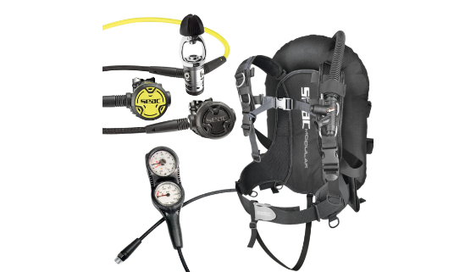
BOYLE'S LAW & PRESSURE VOLUME
Pressure-Volume Relationship
At constant temperature, gas volume is inversely proportional to absolute pressure:
Operational Impact: As depth increases, gas volume shrinks and air density increases proportionally. At 3.0 ata (20m), gas volume is 1/3, consuming cylinder gas 3 times faster than at the surface!

Slide 11


DALTON'S LAW OF PARTIAL PRESSURES
Sum of Partial Pressures: The total pressure exerted by a gas mixture is the sum of partial pressures of individual component gases.
Oxygen Toxicity Limit: Air contains 21% Oxygen ($O_2$). Maximum working limit $ppO_2 = 1.4\text{ ata}$ is reached at 56 meters on standard air.
Nitrogen Narcosis Risk: High $ppN_2$ at depths beyond 30m exerts an intoxicating anesthetic effect on the central nervous system.

Slide 12


HENRY'S LAW & GAS DISSOLUTION
Gas Solubility Mechanics
On-Gassing & Off-Gassing
Bottom Time: Tissues absorb Nitrogen until saturation is reached at ambient pressure.
The amount of gas dissolved in a liquid is directly proportional to the partial pressure of that gas above the liquid.
Ascent Elimination: Controlled ascent rates allow Nitrogen to diffuse back into the bloodstream and be safely exhaled through the lungs.
During descent, elevated partial pressure forces inert Nitrogen gas to dissolve into body tissues.
Safety Stop: A 3-minute stop at 5m mitigates micro-bubble formation.

Slide 13


CHARLES'S & GAY-LUSSAC'S LAWS
Temperature & Pressure Direct Ratio: At constant volume, pressure varies directly with absolute temperature.
Fast Cylinder Filling Heat: Rapidly filling diving cylinders increases internal gas temperature, showing artificially high pressures.
In-Water Cooling Drop: When a hot cylinder is submerged in cold ocean water, temperature drops, causing working pressure to drop proportionally.

Slide 14
Diving Physiology & Medical
Section 03: Barotrauma, Decompression Sickness & Hyperbaric Emergency Care

Slide 15






TYPES OF BAROTRAUMA
Middle Ear Squeeze
Sinus & Mask Squeeze
Pulmonary Over-Expansion
Failure to equalize Eustachian tubes during descent causes pressure differential across the eardrum, risking tympanic membrane rupture.
Failure to exhale into the mask mask space or blocked sinus passages creates negative pressure, causing facial tissue capillary damage.
Holding breath during ascent causes expanding lung air to rupture alveoli, resulting in pneumothorax or Arterial Gas Embolism (AGE).

Slide 16
DECOMPRESSION SICKNESS (DCS)
Mechanism & Pathology
Type II DCS & Manifestation
If ascent is too rapid, Nitrogen comes out of physical solution faster than it can be exhaled, forming inert gas micro-bubbles in blood vessels and joint tissues.
Type II DCS (Severe): Neurological numbness, paralysis, respiratory distress ("chokes"), circulatory shock, or inner ear vertigo.
Type I DCS: Joint pain ("The Bends"), localized skin itching, lymphatic swelling.
Mitigation: Strict adherence to dive computer NDL limits, ascent rates under 9-18m/min, and mandatory safety stops.

Slide 17
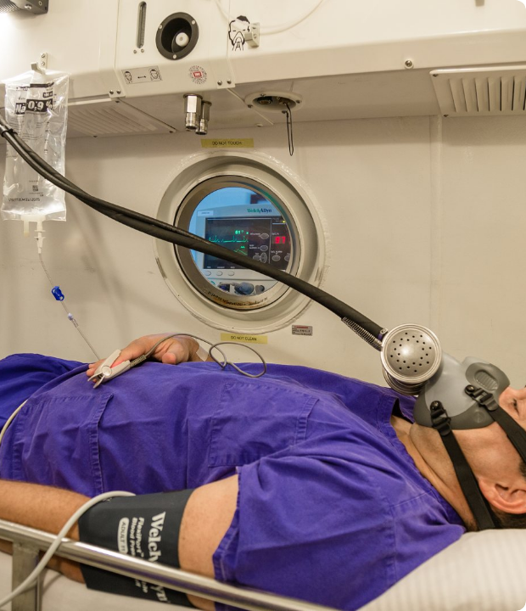
HYPERBARIC MEDICAL TREATMENT
Emergency Action Protocols
First Aid: Administer 100% surface oxygen immediately via non-rebreather mask to establish an oxygen gradient and accelerate Nitrogen off-gassing.
Hydration & Lay Flat: Keep casualty supine, administer oral/IV fluids, and keep warm.
Recompression Chamber: Definitively treated in a multiplace recompression chamber using US Navy Treatment Tables (e.g., Table 6) to mechanically crush bubbles.

Slide 18
NITROGEN NARCOSIS & O2 TOXICITY
Nitrogen Narcosis ("Martini Effect")
Oxygen Toxicity (CNS)
High inert gas partial pressure causes a narcotic, intoxicating effect on central nervous system lipid membranes at depths exceeding 30m.
Occurs when breathing high partial pressures of Oxygen ($ppO_2 \ge 1.4\text{ ata}$).
VENTID Symptoms: Visual disturbances, Ear ringing, Nausea, Twitching/Tremors, Irritability, Dizziness, followed by violent grand mal convulsions.
Symptoms: Impaired judgment, loss of dexterity, delayed reaction time, euphoria, or sudden anxiety.

Slide 19
Diving Signals & Communication
Section 04: Hand Signals, Commercial Line Pulls & Electronic Comms

Slide 20





STANDARD HAND SIGNALS
Directional Signals
Status & Safety
Emergency Signals
Ascend / Surface: Thumb pointing upward.
Descend: Thumb pointing downward.
Level Off: Flat hand wave horizontally.
OK: Circle formed by thumb & index finger.
Problem: Hand tilted side-to-side.
Equalize: Pointing finger to ear.
Out of Air: Slash motion across throat.
Share Air: Pointing fingers to mouth.
Hold / Stop: Raised flat palm outward.

Slide 21
COMMERCIAL ROPE PULL SIGNALS
Pull Signal | Tender to Diver (Surface Signal) | Diver to Tender (Submerged Signal)
1 Pull | Are you OK? / Confirm status | I am OK / Arrived at bottom
2 Pulls | Pay out more umbilical line | Give me more umbilical line / slack
3 Pulls | Take up slack / stand by | Take up umbilical line slack
4 Pulls | Come up immediately / emergency | Haul me up immediately / Emergency!

Slide 22
ELECTRONIC & ACOUSTIC COMMS
SSD Hardwire Communications
Wireless Acoustic Transceivers
Utilizes copper communication wires molded into the diver's umbilical bundle attached to helmet microphone and ear speakers.
Used in technical scuba and search/rescue missions without umbilical lines.
Ultrasonic Carrier Waves: Transmits voice signals through water using high-frequency ultrasonic transducers fitted to full-face masks.
Full-Duplex Mode: Allows simultaneous open-mic voice communication between diver, surface tender, and supervisor.

Slide 23
Marine Rules & COLREGS
Section 05: International Maritime Organization Flag Rules & Vessel Signals

Slide 24
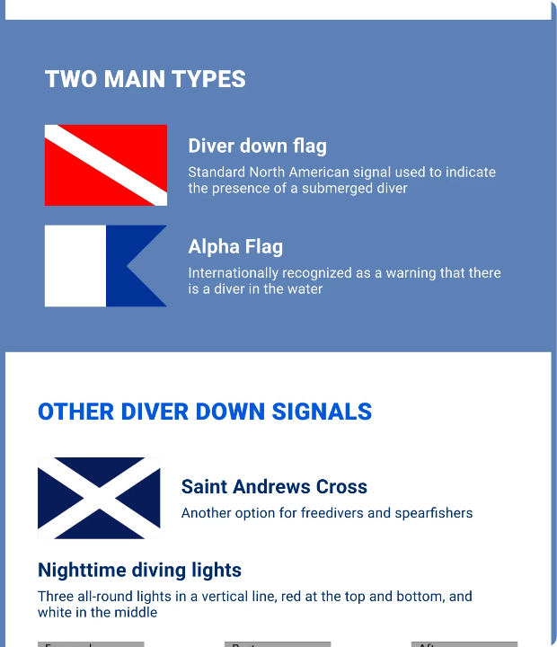
DIVER DOWN FLAG REGULATIONS
Maritime Collision Regulations
Alpha Flag (International Code): Rigid blue and white swallow-tailed flag indicating "I have a diver down; keep well clear at slow speed."
Red & White Flag: Recognized in civilian waters (red with diagonal white stripe).
Clearance Standard: Vessels must maintain at least 50m to 100m distance from displayed dive flags.

Slide 25
DIVE SUPPORT VESSEL NAVIGATION
Restricted Maneuverability (COLREG Rule 27): Dive vessels engaged in commercial operations display day shapes and lights to warn passing marine traffic.
Day Shapes Display: Three vertical shapes displayed in a line: Ball - Diamond - Ball (Restricted Maneuverability).
Night Lights Display: Vertical light array: Red (Top) - White (Middle) - Red (Bottom) masthead lights.
Safe Side Clearance: Green lights/diamonds indicate the clear side to pass; Red lights/balls indicate the obstructed side where umbilical/diver is located.

Slide 26
Navigation & Rescue Protocols
Section 06: Compass Navigation, Natural Orientation & In-Water Rescue

Slide 27
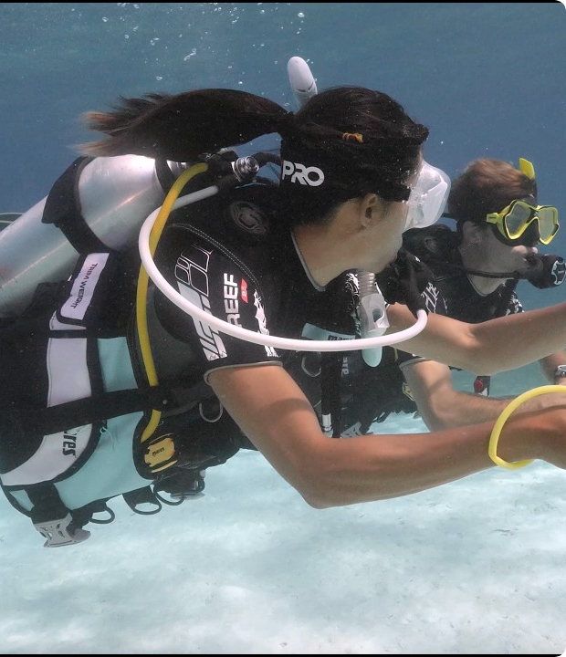
UNDERWATER COMPASS NAVIGATION
Compass Alignment Procedure
Lubber Line: Align the center red lubber line directly with the diver's body center line and direction of travel.
Bezel Setting: Rotate the rotating bezel index marks over the north-seeking magnetic needle.
Reciprocal Course: For a 180-degree return path, turn until the needle points to the opposite index mark, keeping body level and kick cycles measured.

Slide 28



NATURAL NAVIGATION FACTORS
Sand Ripple Patterns
Sunlight & Rays
Depth Contours
Wave action creates sand wave ripples parallel to the shoreline, offering a reliable grid axis for orienting relative to coastlines.
Observing ambient sunlight angle and shadow directions provides a quick directional baseline during daytime shallow water dives.
Following natural seabed slope profiles, reef walls, and current directions ensures accurate return course orientation.

Slide 29
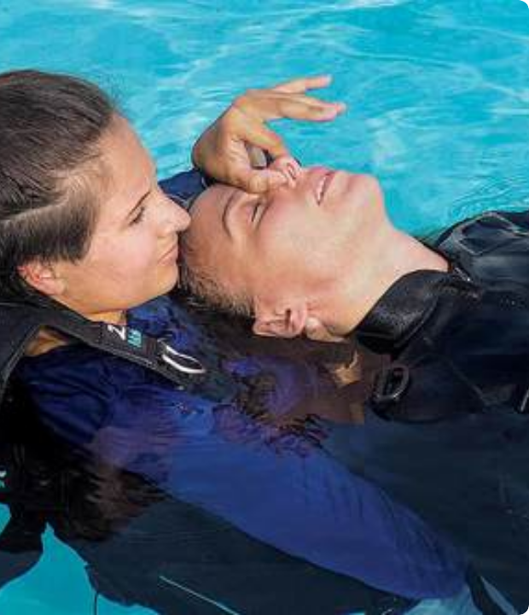
EMERGENCY ACTION & RESCUE
In-Water Rescue Protocol
Pre-Dive Checks (BWRAF): BCD, Weights, Releases, Air, Final OK.
Controlled Ascent: Secure unresponsive diver from behind, maintain head tilt for airway, vent BCDs (<18m/min rate).
Surface Positivity: Inflate BCDs, ditch ballast weights, establish airway, deliver 1 rescue breath every 5 seconds while towing to exit.

Slide 30
Questions & Summary
Comprehensive Submerged Operations Training Complete

Slide 31






IMAGE SOURCES
https://img1.wsimg.com/isteam/ip/d726989b-0d1b-439a-807a-6dfc5d6436b4/blob-a007ede.png/:/cr=t:0%25,l:0%25,w:100%25,h:100%25/rs=w:400,cg:true
Source: mecdco.com
https://www.mikesdivestore.com/cdn/shop/files/SeacModularPackage.jpg?v=1774608034&width=1214
Source: www.mikesdivestore.com
https://o2bonaire.com/wp-content/uploads/2019/06/Recompression-chamber-Bonaire-28.jpg
Source: o2bonaire.com
https://driveaboatusa.com/wp-content/uploads/2024/08/types_of_diver_down_flags-1.webp
Source: driveaboatusa.com
https://i.ytimg.com/vi/pDE-ilJk0tw/maxresdefault.jpg
Source: www.youtube.com
https://storage1.snappages.site/eupr0m0685/assets/images/6275246_1200x800_500.jpg
Source: www.dansa.org

